Slide 1

Q1 PLC with X3EB servo for single-axis motion control
C r e a t e a b e t t e r l i f e t h r o u g h o u r w o r k
© HCFA CORPORATION. All Rights Reserved.
2021/8/30

Slide 2

01
Project Creation
02
EtherCAT Conection Creation
03
Axis Configration
CONTENTS
04
Programing

Slide 3
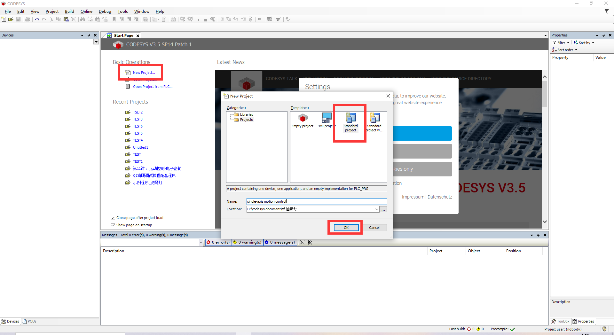
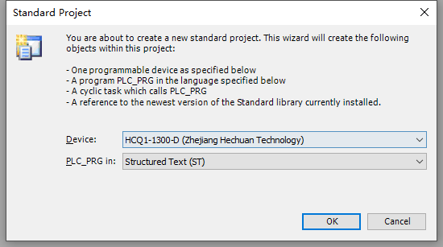
1.Project Creation
Open the CODESYS and choose Standard project
Type the project name and then select the storage location
Choose the cyclic task type

Slide 4
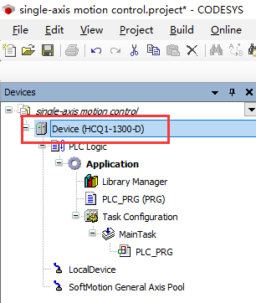
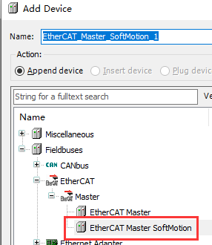
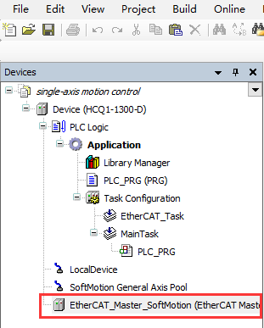
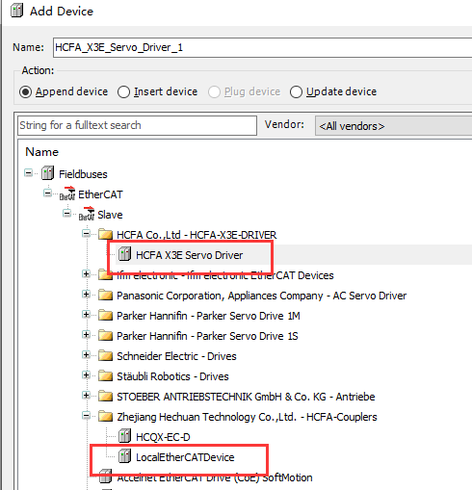
1.Project Creation
Right click the Device to choose Add Device
Select Fieldbuses-EtherCAT –Master，then add the ‘EtherCAT Master SoftMotion’
Right click the EtherCAT_Master_SoftMotion to select the Add Device
Add the ‘LocalEtherCATDevice’ and ‘HCFA X3E Servo Driver’

Slide 5
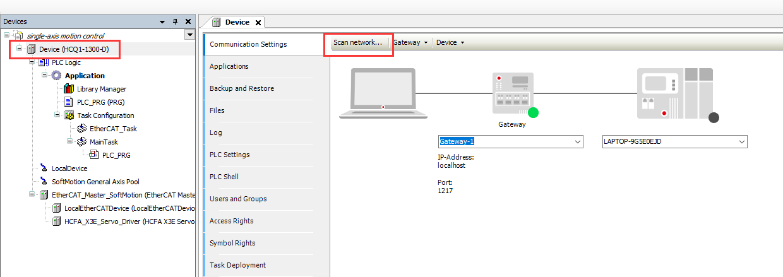
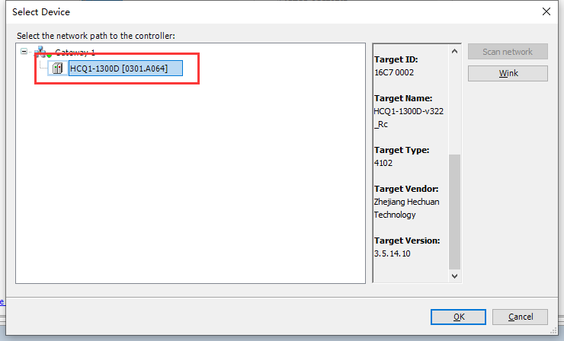
2.EtherCAT Conection Creation
Double-click the Device, then choose the Scan network
Select the’HCQ1-1300D’ to bulid the conection
Caution:The IP address of PC which link to the PLC need change to 192.168.188.xxx (Connect to the Port 1; if connet to the Port 2 ,the IP address should be 192.168.88.xxx)

Slide 6
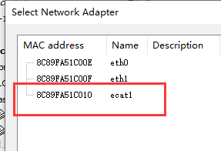
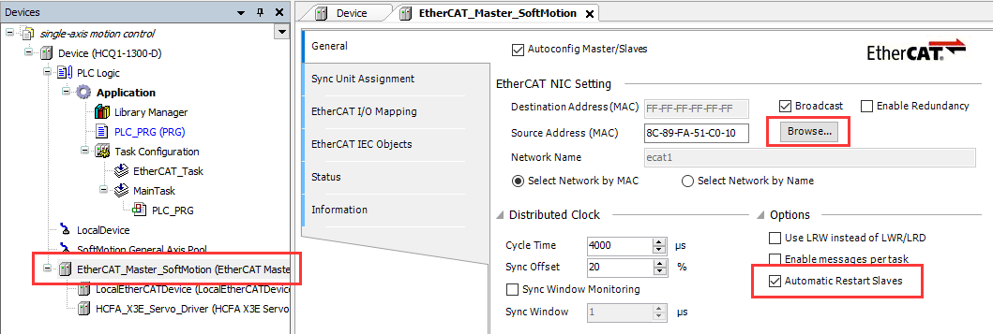
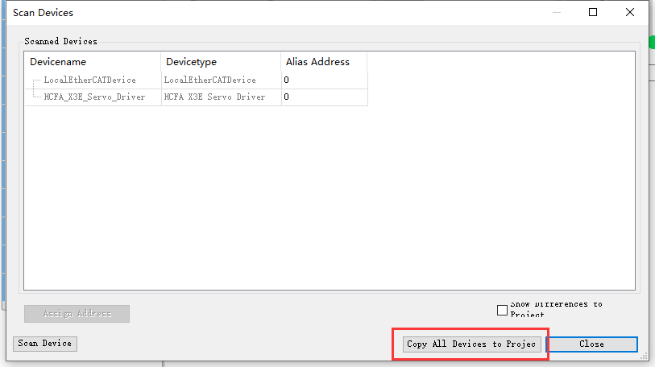
2.EtherCAT Conection Creation
Double-click the EtherCAT_Master_SoftMotion
Click the Source Address – Browse
Select Network Adapter to choose the ecat1 (EtherCAT MAC address)
Tick the opition of ‘Automatic Restart Slaves’
If you do not know the topology of your PLC, you can right click the ‘EtherCAT_Master_SoftMotion’ to Scan Devices and Copy ALL Devices to Project

Slide 7
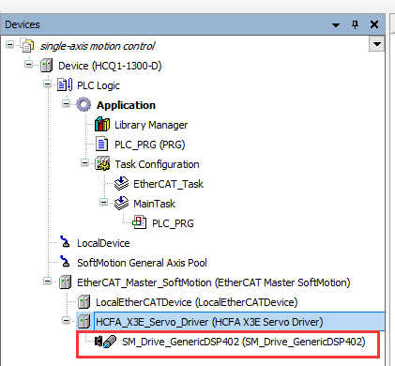
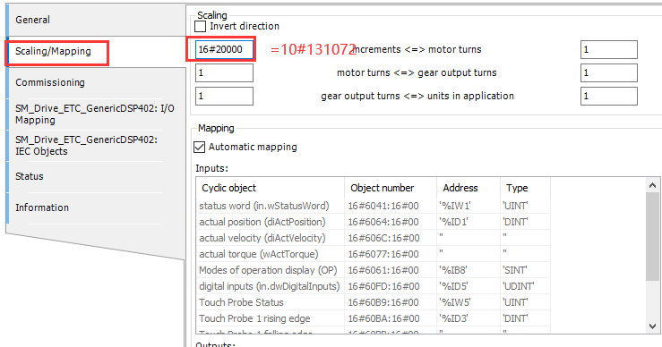
3.Axis Configration
Firstly, add the Axis,
Right click the HCFA_X3E_Servo_Driver (HCFA X3E Servo Driver)
Click the ‘Add SoftMotion Cia402 Axis’
Turn to set the axis parameters
Double-click the SM_Drive_GenericDSP402(SM_Drive_GenericDSP402), choose ‘Scaling/Mapping’
Change the mcrements to ’16#20000’ which equals to 10#131072

Slide 8
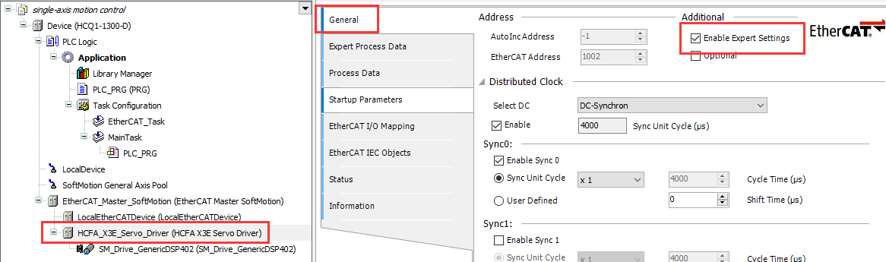
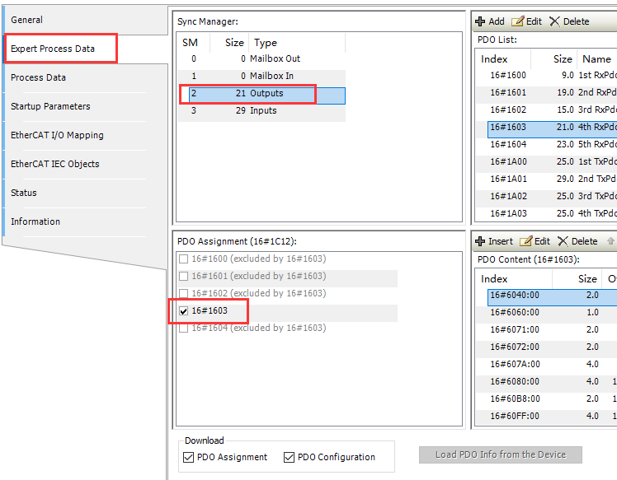
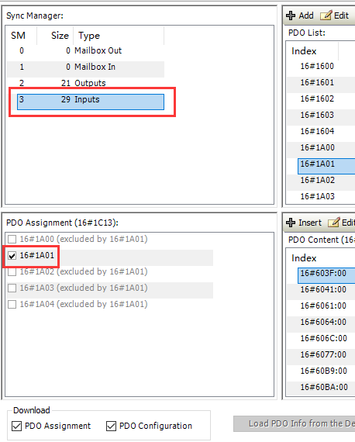
3.Axis Configration
Click the ‘HCFA_X3E_Servo_Driver’, choose ‘General’
Tick the ‘Enable Expert Settings’
Click the ‘HCFA_X3E_Servo_Driver’, choose ‘Expert Process Data’
Select the ’21 Outputs’, change the 16#1600 to 16#1603
Select the ’29 Inputs’, change the 16#1A00 to 16#1A01

Slide 9

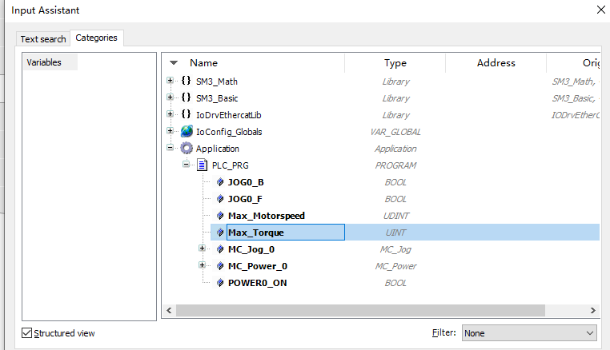
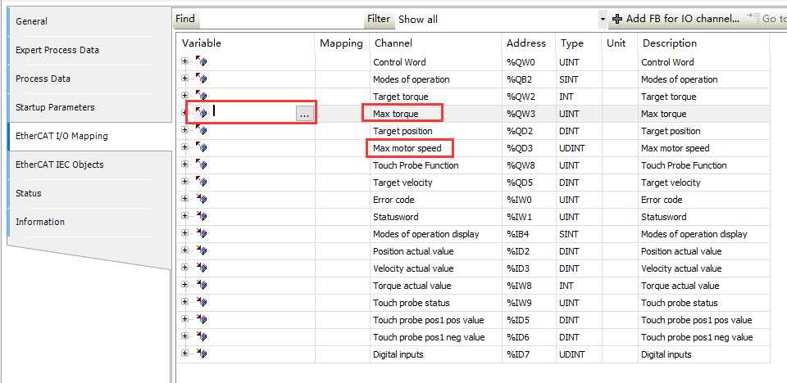
3.Axis Configration
There should definet ‘Max torque’ and ‘Max motor speed’ as a result of last step select different Inuputs and Outputs mode.
At the PLC_PRG, create two variables
Click the ‘HCFA_X3E_Servo_Driver’, choose ‘EtherCAT I/O Mapping’
Connect 2 variables to these channnels

Slide 10
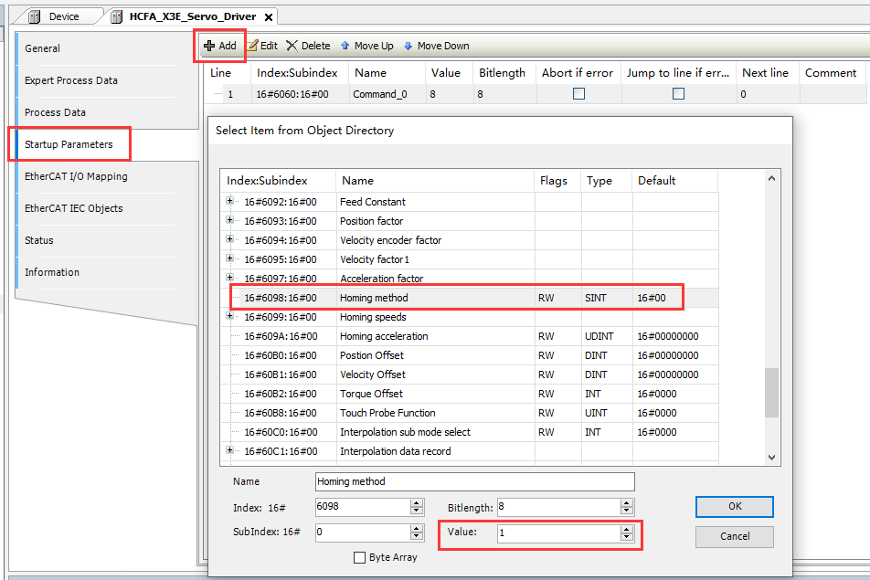
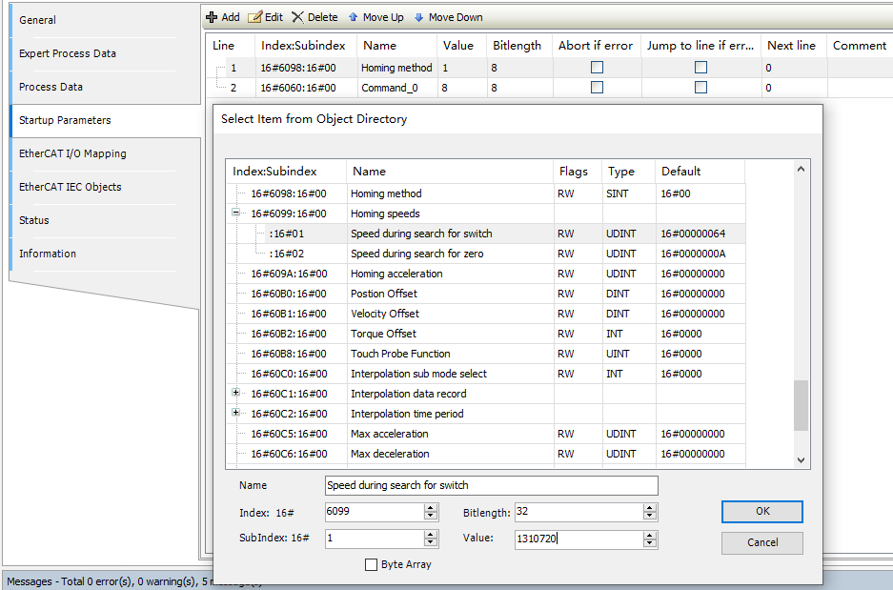
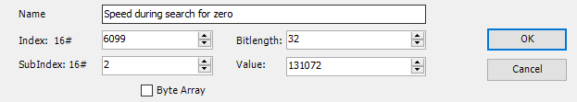
3.Axis Configration
Click the ‘HCFA_X3E_Servo_Driver’, choose ‘Startup Parameter’
Click the ‘Add’, Tick the ’16#6098:16#00 Homing method’ and set the Value to 1
This means that the negative limit position and the Z-pulse signal are used to homing funtion.
Click the ‘Add’, Tick the ’16#6099:16#01’ and set the Value to 1310720;This means that the switch speed of motor is 10 rps
Click the ‘Add’, Tick the ’16#6099:16#02’ and set the Value to 131072;This means that the zero speed of motor is 1 rps

Slide 11
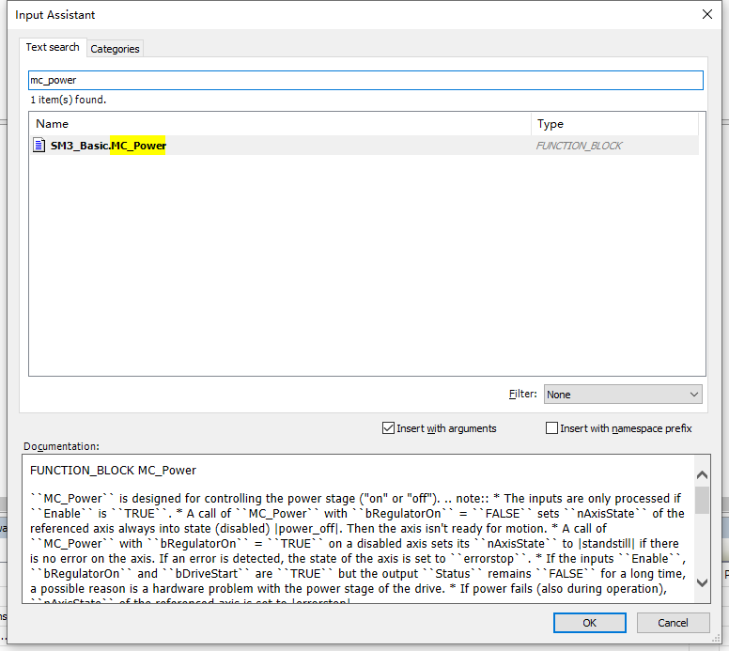
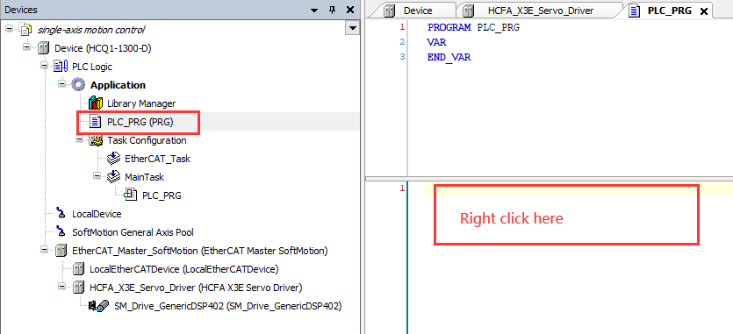
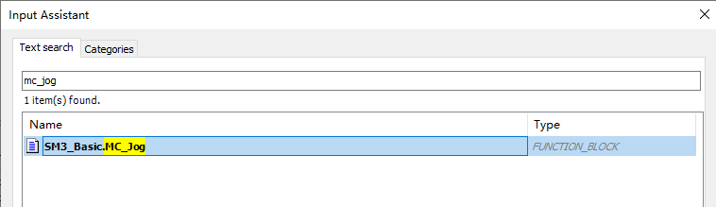
3.Axis Configration
Click the ‘PLC_RPG’
At Code writing area, right click to choose ‘Input Assisment’ to add function block
For the first experiment (inching fuction), choose the MC_POWER and MC_JOG functions

Slide 12
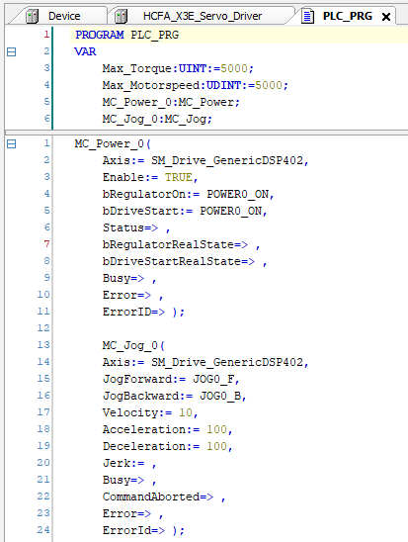
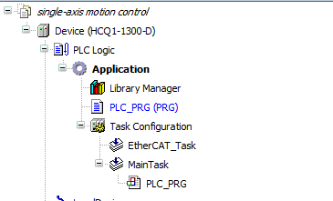
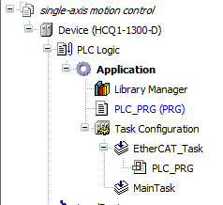
4.Programing
For the first experiment (inching fuction), the simple procedures shows in right figure
The velocity of motor set to 10, unit is rps
Move the PLC_PRG from ‘Main_task’ to ‘EtherCAT_task’

Slide 13
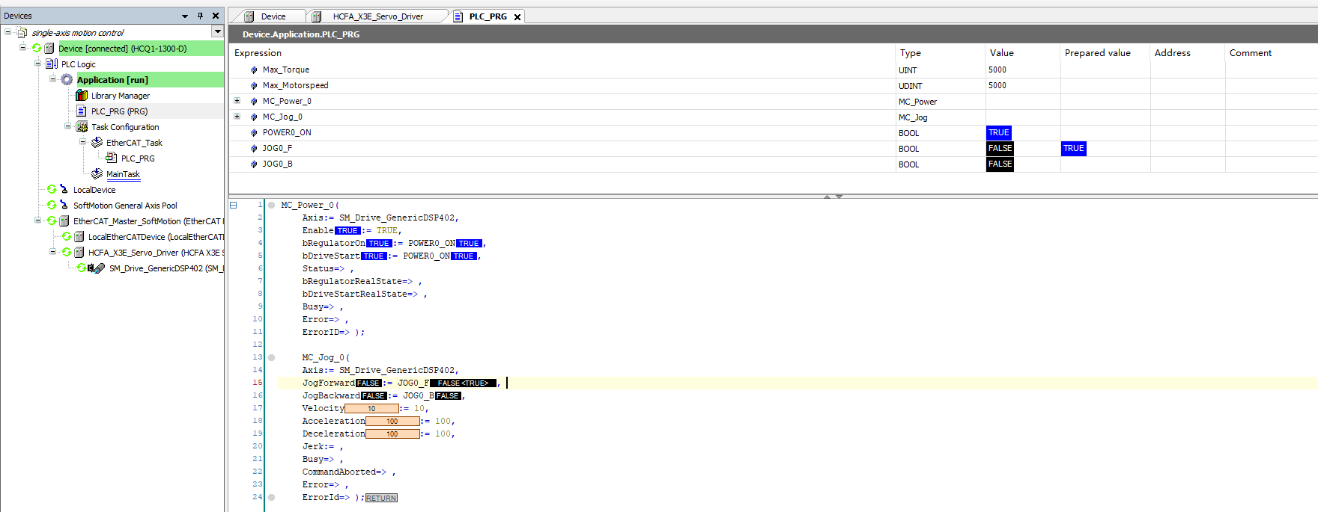
4.Programing
Then Bulid up the program and Login to operate the system
Give TRUE to JogF or JogB can control the axis inching to move forward or backward

Slide 14



To be the most valuable industrial automation core components and solution provider

