Slide 1

Multiple communications between Q1 PLC and HMI
C r e a t e a b e t t e r l i f e t h r o u g h o u r w o r k
© HCFA CORPORATION. All Rights Reserved.
2021/9/1

Slide 2

01
ModbusTCP/IP Q1 as Master
02
ModbusTCP/IP HMI as Master
03
Modbus RTU Q1 as Master
CONTENTS
03
Modbus RTU HMI as Master
03
Appendix

Slide 3
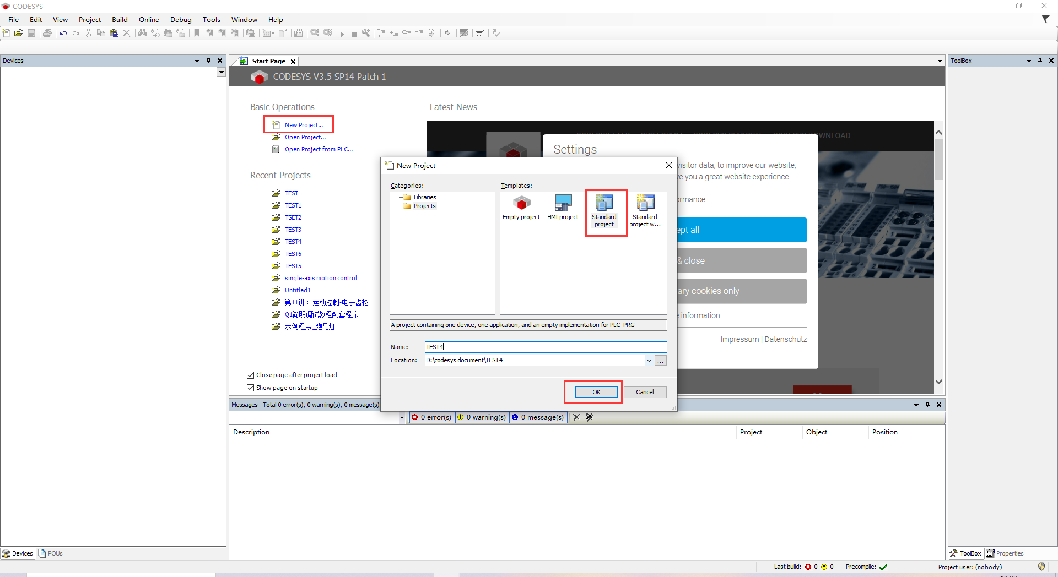
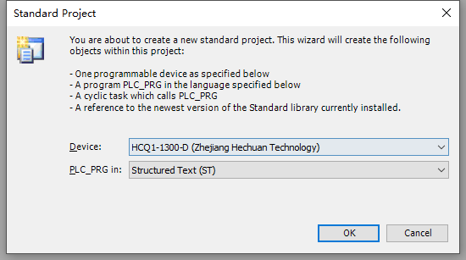
Codesys Project creation
Open the CODESYS and choose Standard project
Type the project name and then select the storage location
Choose the Device ‘HCQ1-1300-D’cyclic task type Structured Text (ST).
Caution: Make sure that the PC has the Q1 description file installed, see Appendix for how to install the description file

Slide 4
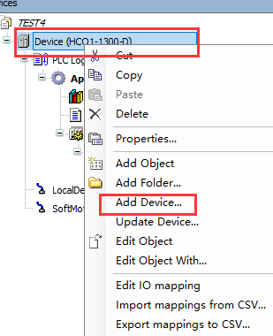
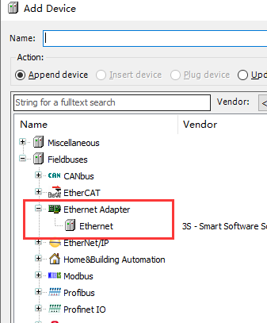
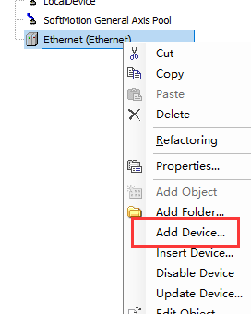
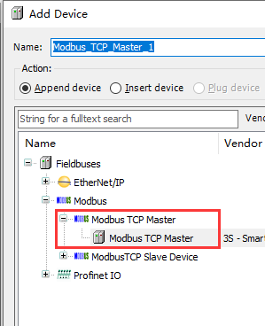
1. ModbusTCP/IP Q1 as Master
1.1 Project creation
Right click the Device to choose Add Device
Select Fieldbuses-Ethernet Adapter –Ethernet，then add the ‘Ethernet’
Right click the Ethernet to select the Add Device
Add the ‘Modbus TCP Master’

Slide 5
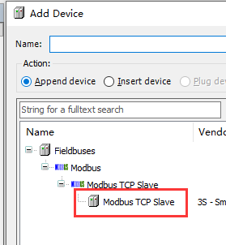
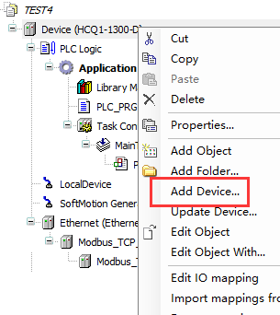
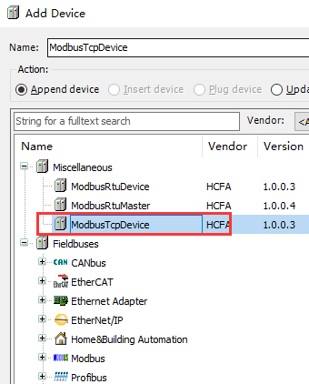
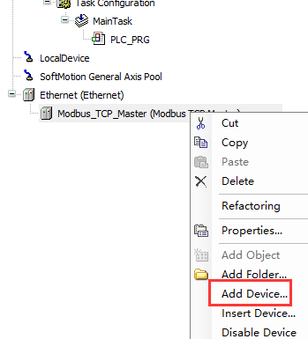
1. ModbusTCP/IP Q1 as Master
1.1 Project creation
Then right click the Modbus TCP Master to add device – Modbus TCP Slave
Right click Device - Add Device
Then find Add Device - Mscellaneous - ModbusTcpDevice

Slide 6
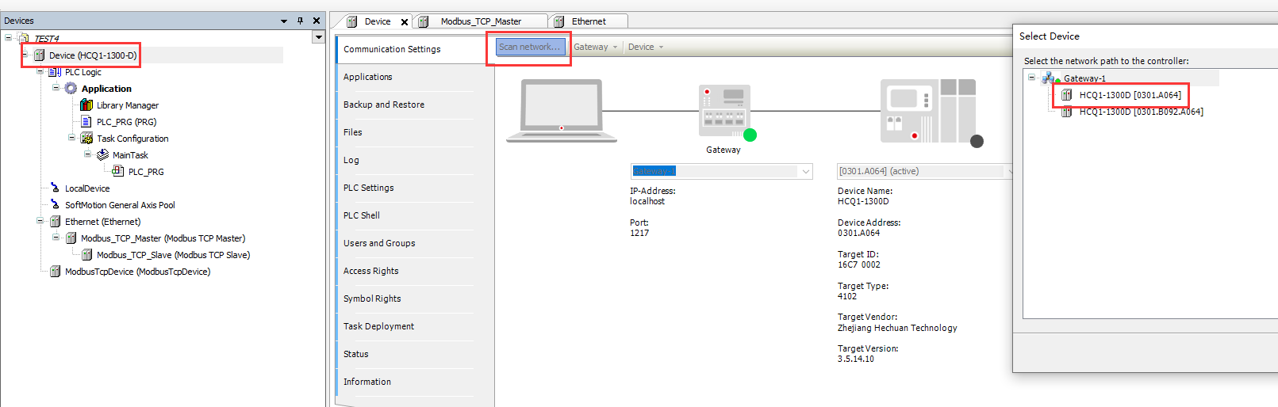
1. ModbusTCP/IP Q1 as Master
1.1 Project creation
Double-click the Device, then choose the Scan network
Select the’HCQ1-1300D’ to bulid the conection
Caution:The IP address of PC which link to the PLC need change to 192.168.188.xxx (Connect to the Port 1; if connet to the Port 2 ,the IP address should be 192.168.88.xxx)
In this experiment, choose Port 1 to connect to thr PC

Slide 7
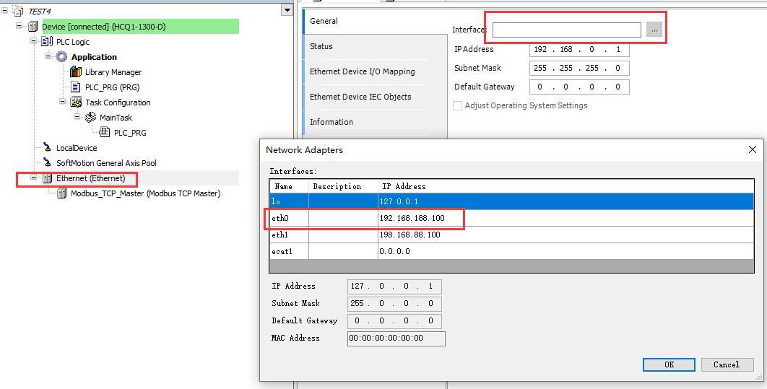
1. ModbusTCP/IP Q1 as Master
1.2 Modbus TCP/IP codesys setting
Double-click the Ethernet, Find General- Interface
In this experiment, we choose port1 connet to the Q1, so the Master IP address should be eth0 192.168.188.100

Slide 8
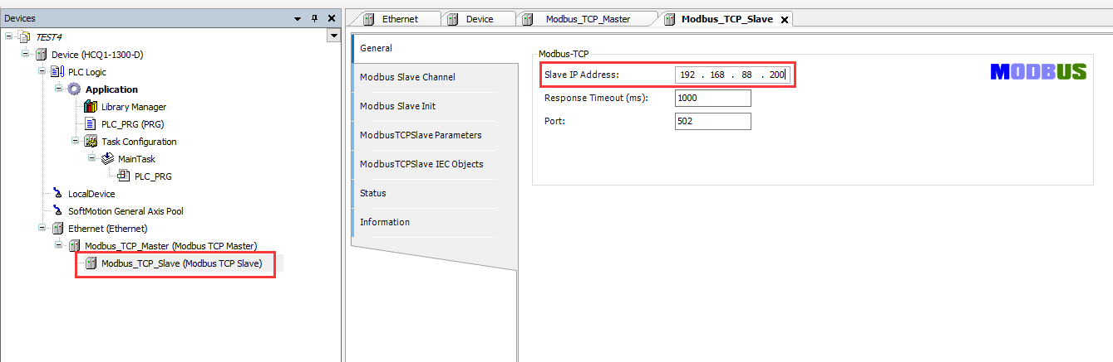
1. ModbusTCP/IP Q1 as Master
1.2 Modbus TCP/IP codesys setting
Double-click Modbus_TCP_Slave, find General- Slave IP Address
This is slave’s IP address, which is IP address of HMI (it should set by the HMI application HCTDesigner)

Slide 9
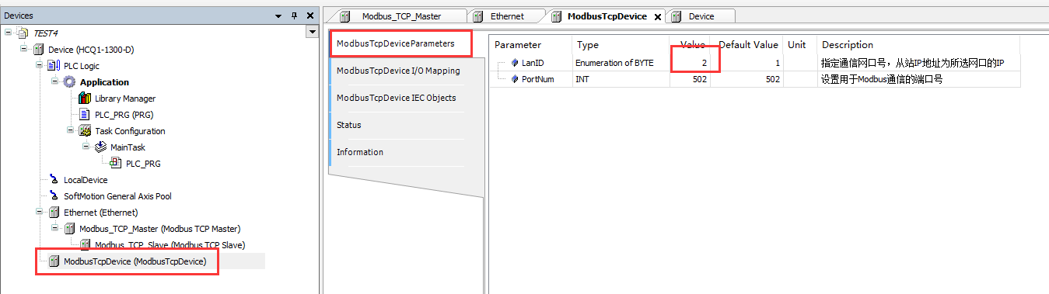
1. ModbusTCP/IP Q1 as Master
1.2 Modbus TCP/IP codesys setting
Double-click ModbusTcpDevice, find ModbusTcpDeviceParameters
Find the Parameter – LanID, because Master(Q1) connet to port1 and Slave(TP2000) connect to port2, this value should be the slave ID (so we choose 2)

Slide 10
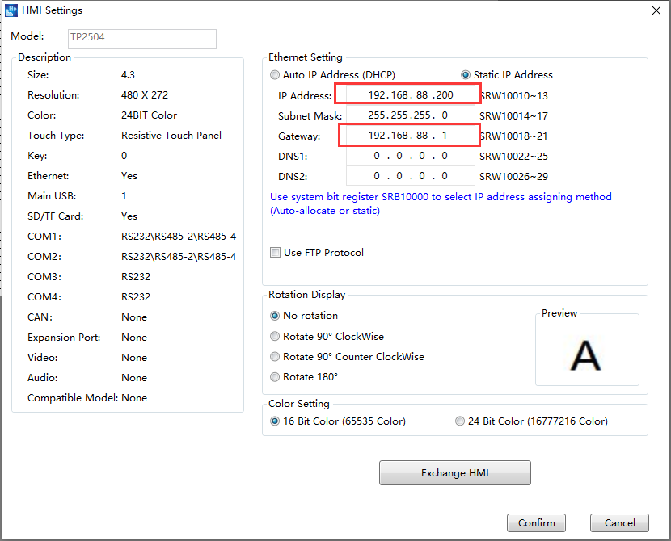
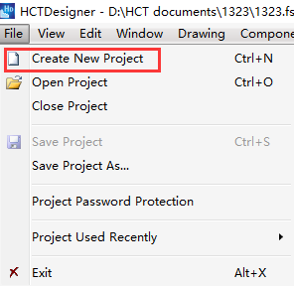
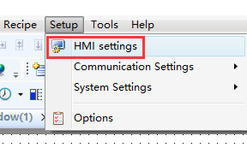
1. ModbusTCP/IP Q1 as Master
1.3 HTCDesigner Project Creation
Click File to Create New Project, type name of project
Find Setup – HMI settings
Change the IP Address 192.168.88.X and Gateway 192.168.88.1, it should be the same band with the IP address of port2 which the touchscreen connected

Slide 11
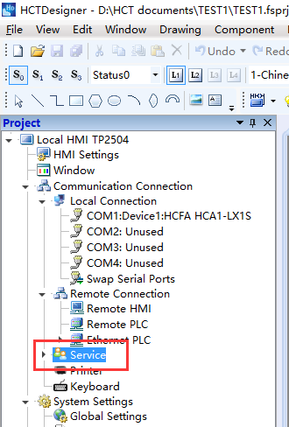
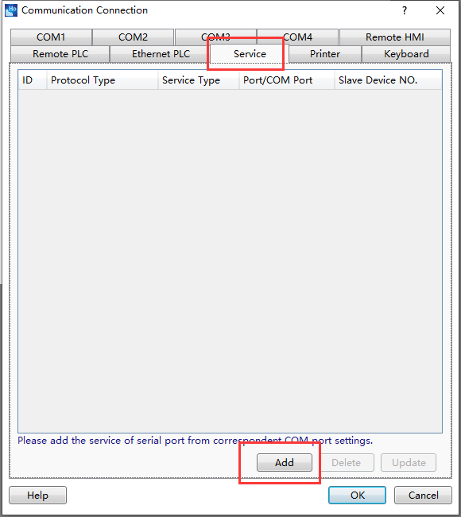
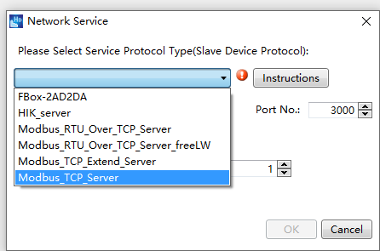
1. ModbusTCP/IP Q1 as Master
1.4 HTCDesigner Comfigration
Find the Service in the Project menu and double click it
Click Add botton, choose the Modbu_TCP_Server

Slide 12
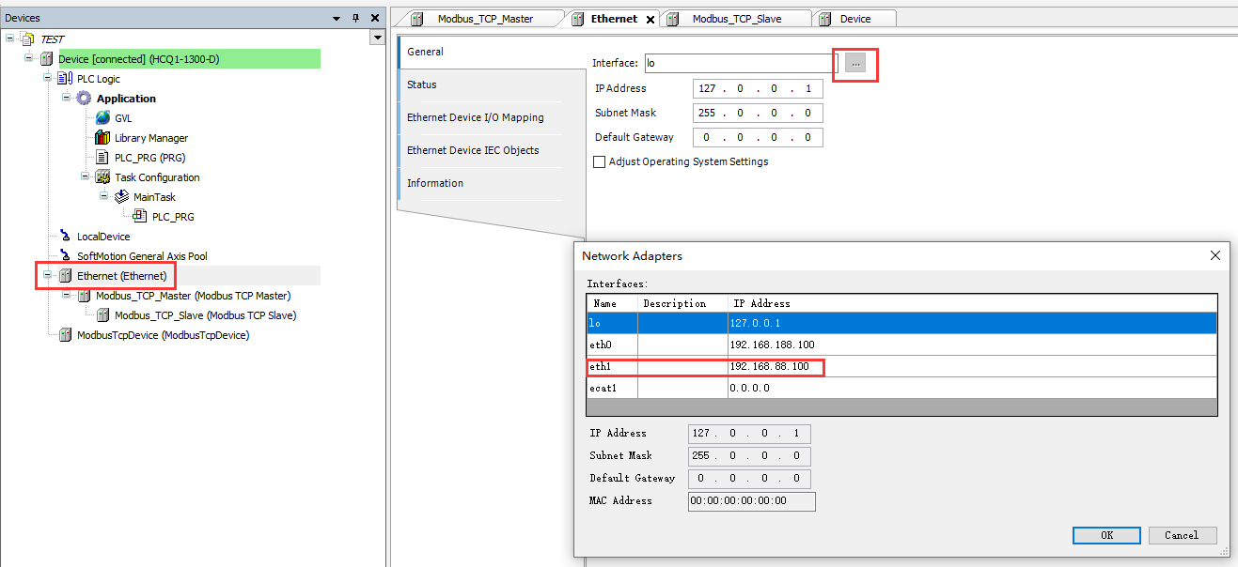
2. ModbusTCP/IP HMI as Master
2.1 Project Creation
The project creation just like 1.1
2.2 Modbus TCP/IP codesys setting
Double-click the Ethernet, Find General- Interface
In this experiment, we choose port2 connet to the HMI, so the Master IP address should be eth0 192.168.88.100

Slide 13
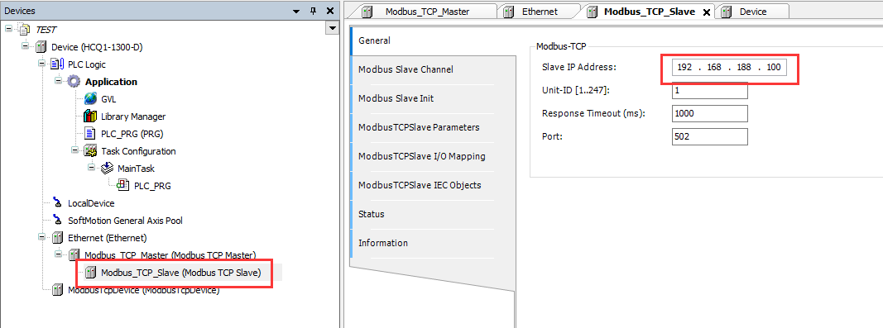
2. ModbusTCP/IP HMI as Master
2.2 Modbus TCP/IP codesys setting
Double-click Modbus_TCP_Slave, find General- Slave IP Address
This is slave’s IP address, which is IP address of Q1 PLC

Slide 14
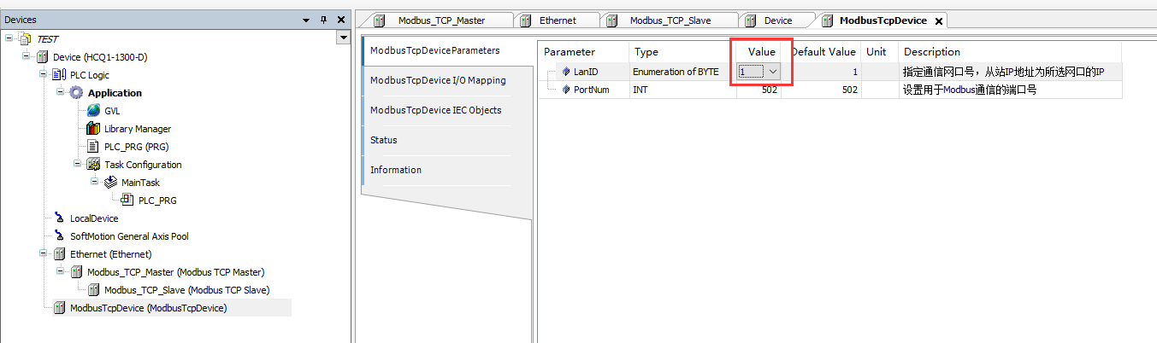
2. ModbusTCP/IP HMI as Master
2.2 Modbus TCP/IP codesys setting
Double-click ModbusTcpDevice, find ModbusTcpDeviceParameters
Find the Parameter – LanID, because Slave(Q1) connet to port1 and Master(HMI) connect to port2, this value should be the slave ID (so we choose 1)

Slide 15
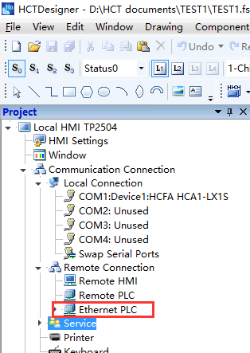
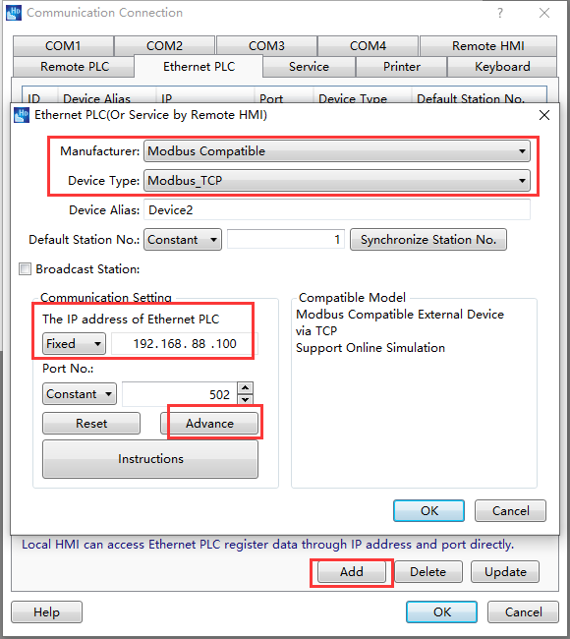
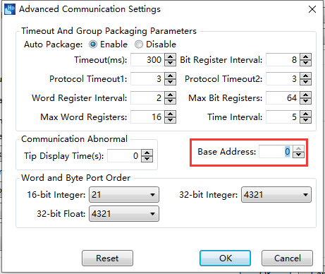
2. ModbusTCP/IP HMI as Master
2.3 HTCDesigner Project Creation
The HTC project creation just like 1.3
2.4 HTCDesigner Comfigration
Find the Ethernet PLC in the Project menu and double click it
Click Add botton, change the ‘Manufacture’ and ‘Device Type’
Then set the IP address of Ethernet PLC 192.168.88.100
Click ‘Advance’, set the Base Address as 0

Slide 16
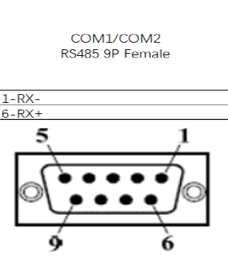
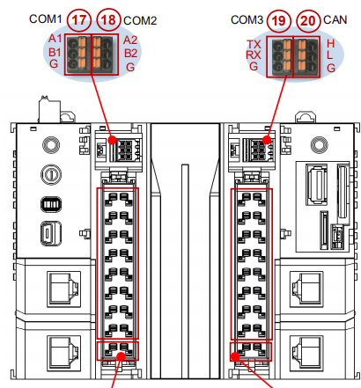
ModbusRTU
The Codesys project creation just like the beginning of the PPT
Device connection
The connection method of pins of RS 485 Plugs, pin 6 connect to the positive pole (like COM1-A1)
Pin 1 connect to the negative pole, like COM1-B1

Slide 17
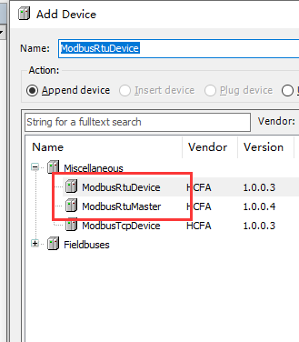
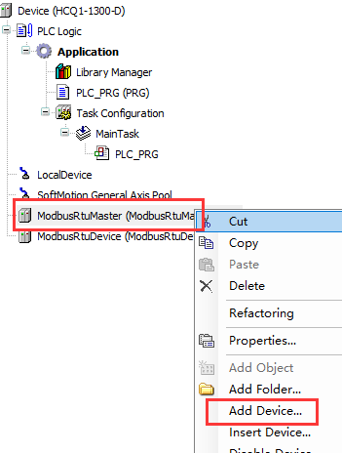
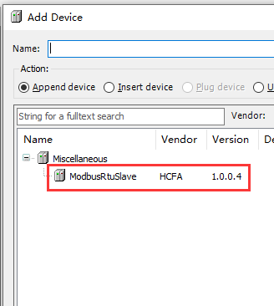
3. Modbus RTU Q1 as Master
3.1 Project creation
Right click the Device to choose Add Device
Select and add ‘Miscellaneous – MobusRtuMaster’，then add the ‘MobusRtuDevice’
Right click the MobusRtuMaster to select the Add Device
Add the ‘ModbusRtuSlave’

Slide 18
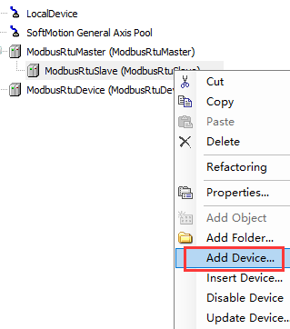
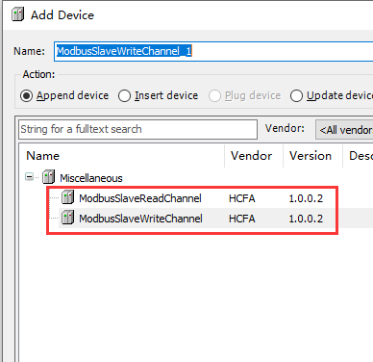
3. Modbus RTU Q1 as Master
3.1 Project creation
Right click the ModbusRtuSlave to choose Add Device
Select and add ‘Miscellaneous – MobusSalveReadChannel’ and ‘Miscellaneous – MobusSalveWriteChannel’

Slide 19
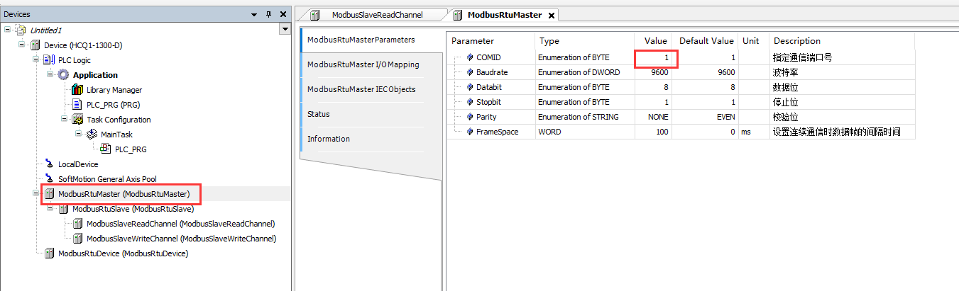
3. Modbus RTU Q1 as Master
3.2 Modbus RTU codesys setting
Double-click ModbusRtuMaster, find ModbusRtuMasterParameters
This is parameter of RTU Master, as for this experiment, we choose com1 to connect with HMI by RS485, so in COMID should set the value as 1.
Other parameters should depend on requires to set, such as Baudrate, Stopbit and Parity

Slide 20
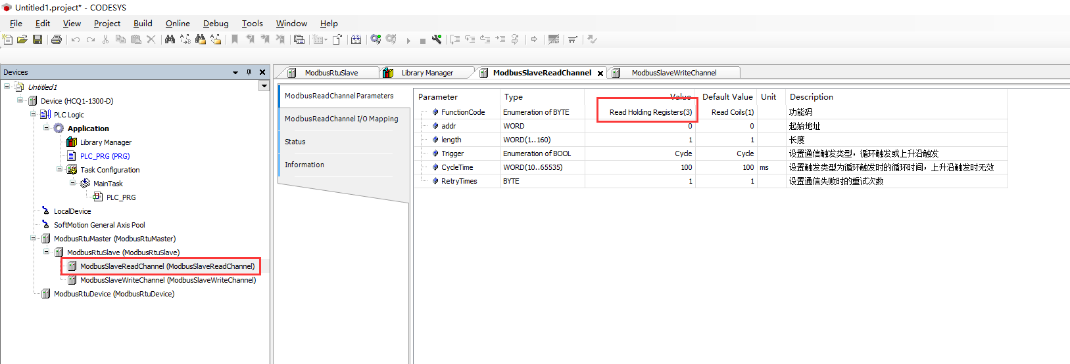
3. Modbus RTU Q1 as Master
3.2 Modbus RTU codesys setting
Find the MidbusSlaveReadChannel - ModbusReadChannelParameters, change the FunctionCode to ‘Read Holding Registers(3)’
There are almost 6 parameters, it depends on which type data you need

Slide 21
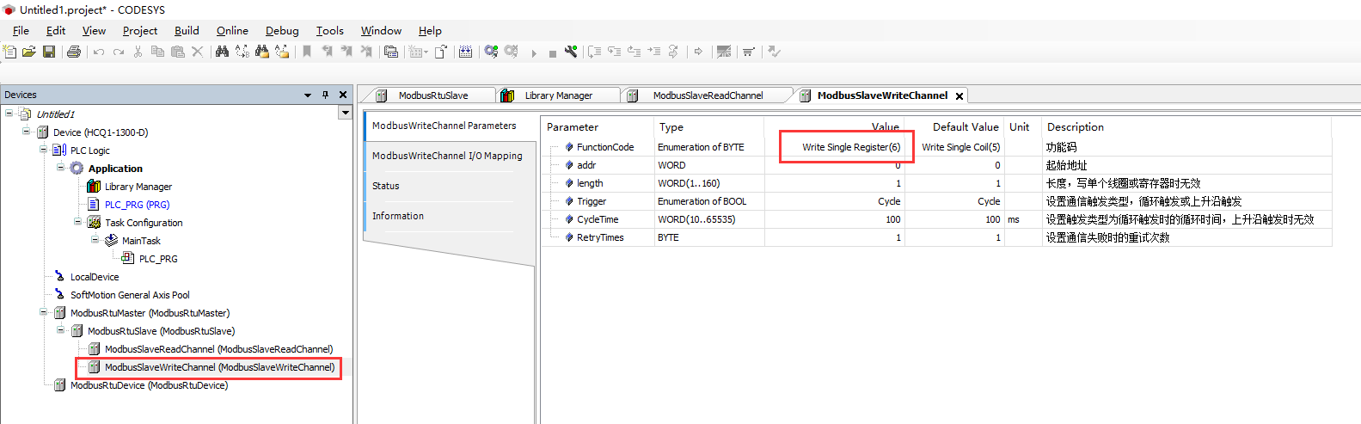
3. Modbus RTU Q1 as Master
3.2 Modbus RTU codesys setting
Find the ModbusSlaveWriteChannel – ModbusWriteChannelParameters, change the FunctionCode to ‘Write Single Register(6)’
All these 6 parameters depend on which kind of data type you need

Slide 22
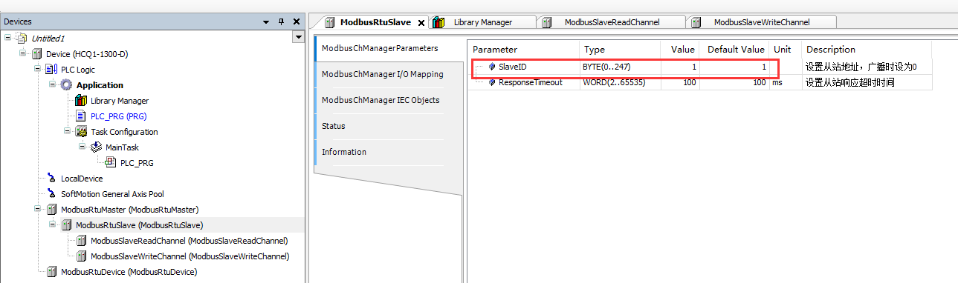
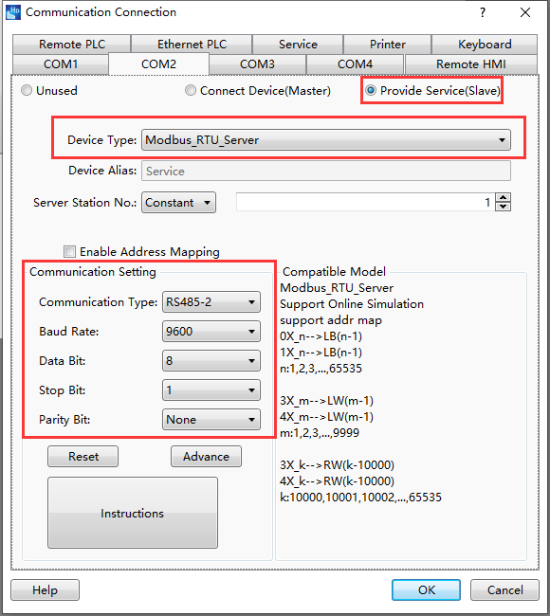
3. Modbus RTU Q1 as Master
3.3 Modbus HTCDesigner codesys setting
In the Codesys, find ModbusRTUSlave – ModbusChManagerParameterss – SlaveID, this value should be same as HTCDesigner – Communication Connection – Server Station No, so this experiment choose 1
The HTCDesigner project creation just like 1.3
Then set the configuration of the communication setting in the communication connection (shows in right figure)
Caution: the communication setting should be same as ModbusRtuMasterParameters in codesys

Slide 23
4. Modbus RTU HMI as Master
4.1 Project creation
Right click the Device to choose Add Device
Select and add ‘Miscellaneous – MobusRtuMaster’，then add the ‘MobusRtuDevice’

Slide 24
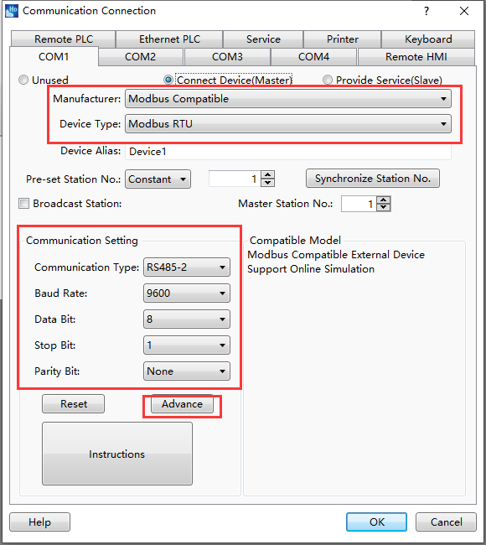
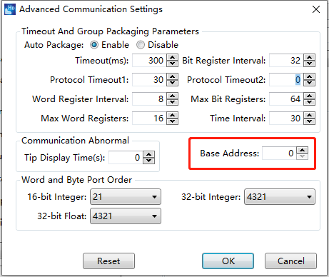
4. Modbus RTU HMI as Master
4.2 Modbus RTU codesys setting
When the HMI as Master, all the codesys RTU setting just like 3.2
4.3 Modbus RTU HTCDesigner setting
The HTCDesigner project creation just like 1.3
Then set the configuration of the communication setting in the communication connection (shows in right figure)
In Advance, need set the base address as 0, which means address offset
Caution: the communication setting should be same as ModbusRtuMasterParameters in codesys

Slide 25
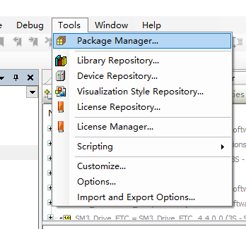
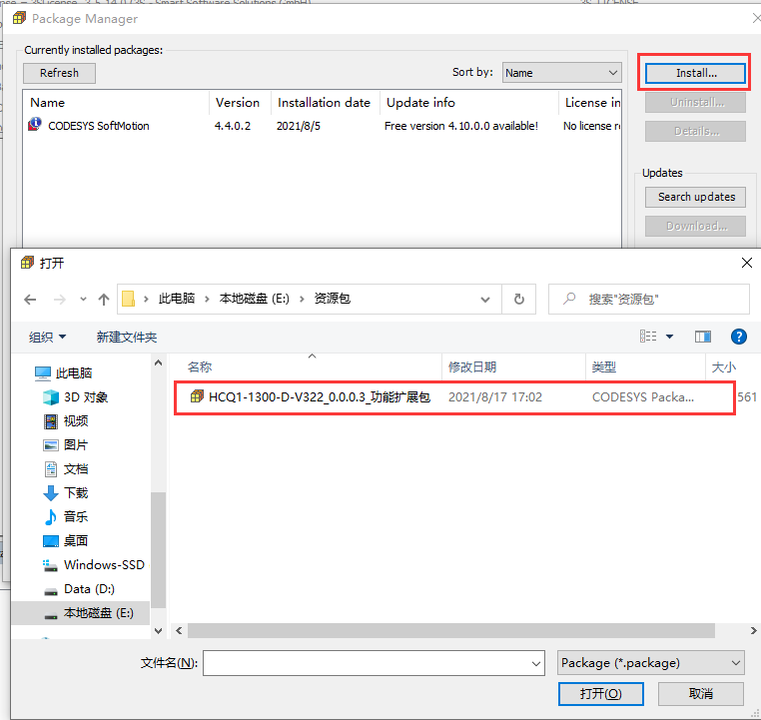
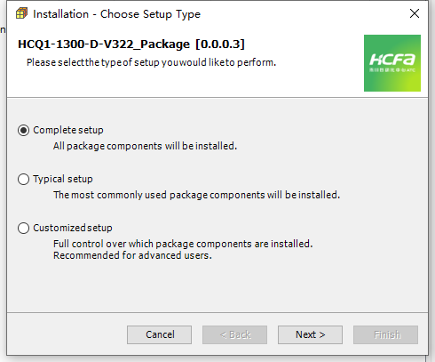
5.Appendix
Device description files are installed using Q1 as an example, the rest of the description files (including general IO, X3T driver, high speed count) are also available in the folder
1. Find Tools → Package Manager
2. Click Install, find the package to open
3. Choose Complete setup - Next

Slide 26
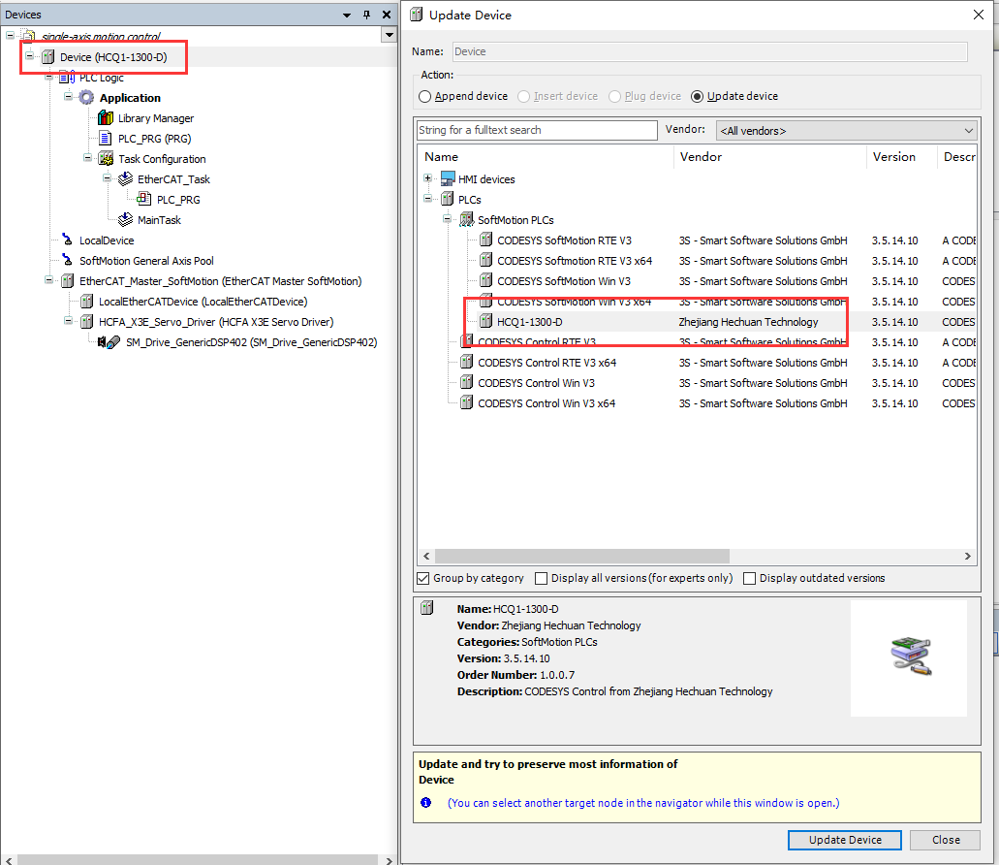
5.Appendix
If the user needs to change the PLC program running platform, when the project has been created, you need to right click Device→Update Device in the Device tab on the left side of the interface, you can switch the PLC program running platform

Slide 27



To be the most valuable industrial automation core components and solution provider

